Slide 1
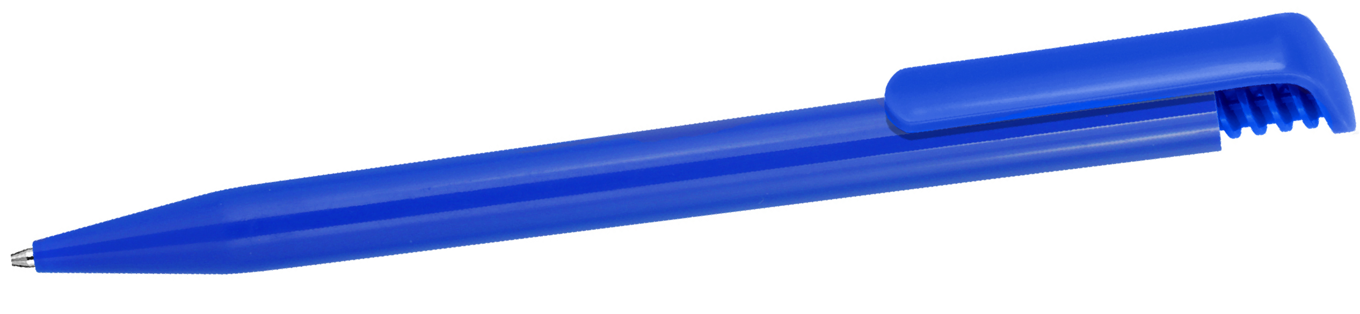
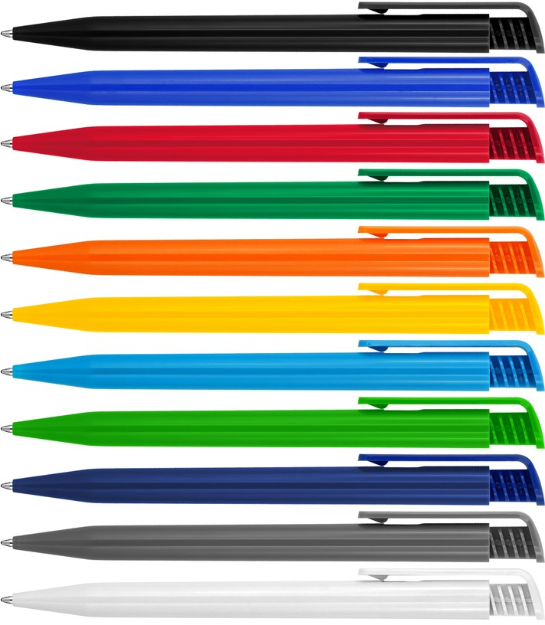
Z895 Plastic Pen Ballpoint Gloss Colours Tia
Tia Ballpoint Pen is a retro styled classic with a push button, retractable black ballpoint.
The barrel can be screen or pad printed with your client's promotional logo or personalisation for a professional gift idea.
Slim type refill - German ink - 1,000m.
Push button
Retractable ballpoint
Black ink
push
quality
button
slim type
refill
Packaging info
Shipping Carton Qty: 1,000 Shipping Carton Size:
53 x 31 x 22cm (LxWxH) Carton Weight (kg): 15
Colours
Black
Blue
C Red
D Green
Print Area
Pad Print: 50 x 5mm
Screen Print (barrel): 50 x 25mm
F Orange
G Yellow
K Bright Blue
L Bright Green
O Navy Blue
V Grey W White

