Slide 1
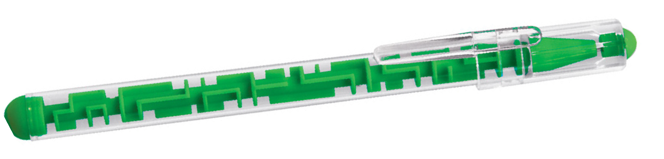
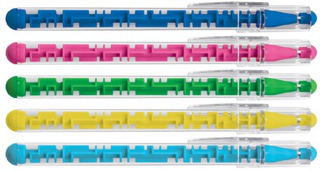
Z848 Plastic Pen Ballpoint Lenny
The Lenny Ballpoint pen has a surprise maze game inside the barrel and a craze game going on on the outside with the styling.
Black ballpoint with cap from a quality Slim type refill - German ink - 1,200m.
Pad or screen printed with your client's promotional logo on the barrel, this pen will amuse and impress as a branded gift.
Ballpoint with cap,
Maze game inside barrel
Black ink
with
slim
maze
type
game
refill
Packaging info
Shipping Carton Qty: 1,000 Shipping Carton Size:
53 x 31 x 22cm (LxWxH) Carton Weight (kg): 15
Colours
A Bue
B Pink
C Green
Print Area
Pad Print (barrel): 50 x 8mm Screen Print (barrel): 50 x 25mm
D Yellow
F Light Blue

