Slide 1
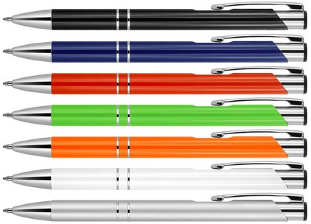
Z776 Metal Pen Ballpoint Executive EU Julia
Don’t sacrifice good design for affordability. Enjoy both with the Julia EU Metal Ballpoint Pen, whose sleek metal construction allows
for sharp looks at little expense.
Available in a range of colourways. Can be pad printed, full colour digital printed, and engraved.
Click action
Retractable ballpoint
Black ink
print
click
slim
or
action
type refill
engrave
1,000m
Packaging info
Shipping Carton Qty: 500 Shipping Carton Size:
30 x 35 x 53cm (LxWxH) Carton Weight (kg): 7
Colours
A Black
B Blue
Print Area
Pad (barrel): 50 x 7mm
C Red
D Green
F Orange
Endrave Area
(barrel): 50 x 7mm
Engrave colour: White
W White
X Silver

