Slide 1
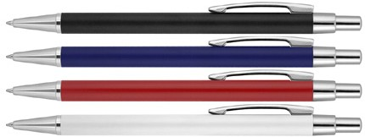
Z765 Metal Pen Ballpoint Executive Matte Ivy
17.5g metal barrel.
Click action
Retractable ballpoint
Black ink
print
click
Slim
or
action
type refill
engrave
1,200m
Packaging info
Shipping Carton Qty: 500 Shipping Carton Size:
54 x 36 x 22cm (LxWxH) Carton Weight (kg): 11.7
Colours
A Black
B Blue
C Red
Print Area
50 x 6mm
Engrave Area
50 x 6mm
Engrave Colour: Chrome
W White

