Slide 1
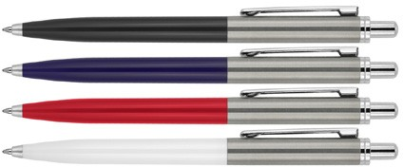
Z764 Metal Pen Ballpoint Executive Ropo
Parker type refill - German ink - 4,000m.
Push Button
Retractable ballpoint
Black ink
print
push
Parker
or
button
type refill
engrave
4,000m
Packaging info
Shipping Carton Qty: 500
Shipping Carton Size: 53 x 39.5 x 23.5cm (LxWxH)
Carton Weight (kg): 10
Colours
A Black GT
B Blue GT
C Red
W White
Print Area
Pad Print (barrel): 40 x 7mm
Engrave Area
Engrave (barrel): 40 x 7mm
Engrave Colour: Silver

