Slide 1
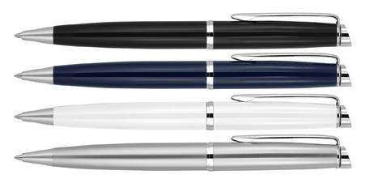
Z760 Metal Pen Ballpoint Prestige Chrome Trim Hubert
Style meets substance in the Hubert Chrome Trim Metal Ballpoint Pen.
Featuring a colored metal barrel with elegant chrome highlights.
Contains a Parker type refill with German ink rated to 3,000m.
Available in a range of colours and suitable for pad print, digital print, and mirror chrome engraving.
Twist Action
Retractable ballpoint
Black ink
print
twist
Parker
or
action
type refill
engrave
3,000m
Packaging info
Shipping Carton Qty: 500 Shipping Carton Size:
45 x 44 x 20cm (LxWxH) Carton Weight (kg): 14
Colours
A Black
B Blue
W White
Print Area
Pad Print (barrel): 45 x 7mm
Engrave Area
Engrave (barrel): 45 x 7mm Engrave Color: Mirror Chrome
X Silver

