Slide 1
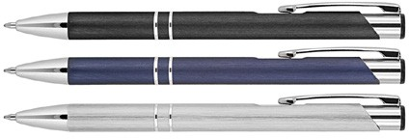
Z707 Metal Pen Ballpoint Executive Brushed Julia
The Julia Brushed Matte Metal Ballpoint Pen presents a sharp, corporate style with smooth, straight lines.
A push action, retractable ballpoint delivers black ink from a smooth quality Parker type refill - German ink - 4,000m.
This metal promotional pen can be printed with your client's logo or brand to create a fine gift or, alternatively, laser engraved with a white finish for an even classier result.
See Z551 for matching mechanical pencil and Z251 for matching plastic pen.
18g metal barrel.
Push button
Retractable ballpoint
Black ink
print
or
engrave
push
Parker
button
type refill
4,000m
Packaging info
Shipping Carton Qty: 500
Shipping Carton Size: 48 x 16 x 20cm (LxWxH) Carton Weight (kg): 10
Colours
A Black
B Blue
X Silver
Print Area
Pad Print (barrel): 50 x 6mm
Engrave Area
Engrave (barrel): 50 x 6mm Engrave Color: White

