Slide 1
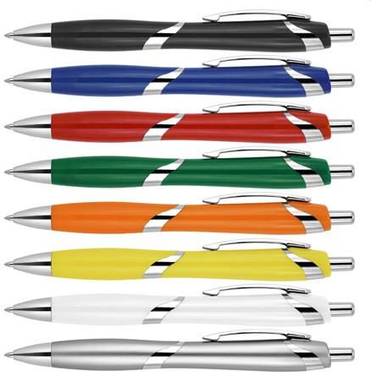
Z697 Plastic Pen Ballpoint Sally
Plastic Parker type refill - German ink - 4,000m
Push Button
Retractable ballpoint
Black ink
push
Parker
button
type
refill
Packaging info
Shipping Carton Qty: 1,000 Shipping Carton Size:
53 x 31 x 22cm (LxWxH) Carton Weight (kg): 14.25
Colours
A Black
B Blue
Print Area
40 x 7mm
C Red
D Green
F Orange
G Yellow
W White X Silver

