Slide 1
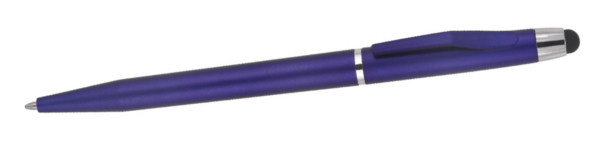
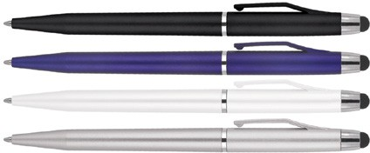
Z633 Plastic Pen Ballpoint Stylus Marcel
The Marcel Stylus Matte Ballpoint Pen offers elegance and stylish simplicity to enhance your client's promotion.
Providing comfort and reliability for the tech savvy, the twist action, retractable ballpoint pen features a black ink Slim type refill - German ink - 1,200m and stylus for touch screens.
Twist action
Retractable ballpoint
Black ink
quality
stylus
slim type
refill
Packaging info
Shipping Carton Qty: 1,000 Shipping Carton Size:
50 x 31 x 21cm (LxWxH) Carton Weight (kg): 13
Colours
A Black
B Blue
W White
Print Area
Pad Print (barrel): 40 x 6mm Pad Print (cap): 35 x 6mm
X Silver

