Slide 1
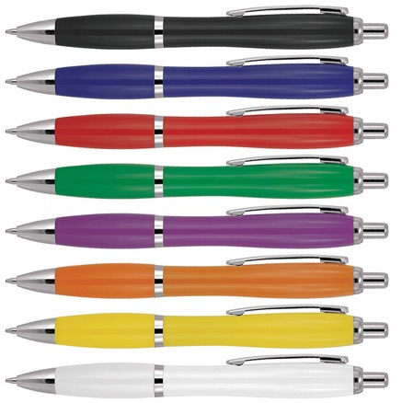
Z632 Plastic Pen Ballpoint Solid Colours Cara
With click action, retractable ballpoint, the Cara Colours Ballpoint Pen is a classic and stylish quality option for your client's next promotion.
The barrel can be pad printed with logo branding to create a classy corporate gift.
Black ink - Parker type refill - German ink - 4,000m.
Click action
Retractable ballpoint
Black ink
click
Parker
action
type
refill
Packaging info
Shipping Carton Qty: 1,000 Shipping Carton Size:
53 x 31 x 22cm (LxWxH) Carton Weight (kg): 15
Colours
A Black
B Blue
Print Area
ad Print (barrel): 50 x 7mm
C Red
D Green
E Purple
F Orange
G Yellow W White

