Slide 1
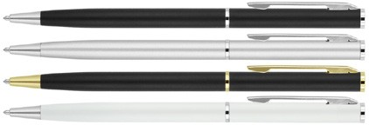
Z561Metal Pen Ballpoint Prestige Matte Valentino
Valentino Matte Metal Ballpoint Pen is a slim instrument of elegance, with a quality metal barrel.
Printed with your client's promotional logo on the cap or barrel, this pen will be a great compliment to the style and quality of your client's business.
Can also be engraved with a classic white finish on the cap.
Comes equipped with precision engineering in the twist action, retractable black ballpoint with Cross type refill.
Twist action
Retractable ballpoint
Black ink
twist
cross
action
type
refill
Packaging info
Shipping Carton Qty: 500
Shipping Carton Size: 33.5 x 17.5 x 33.5cm (LxWxH)
Carton Weight (kg): 18.7
Colours
A Black CT
B Silver CT
N Black GT
Print Area
Pad Print (cap): 40 x 5mm Pad Print (barrel): 40 x 5mm
Engrave Area
Engrave (cap): 40 x 5mm Engrave Color: White
W White CT
print
or
engrave

