Slide 1
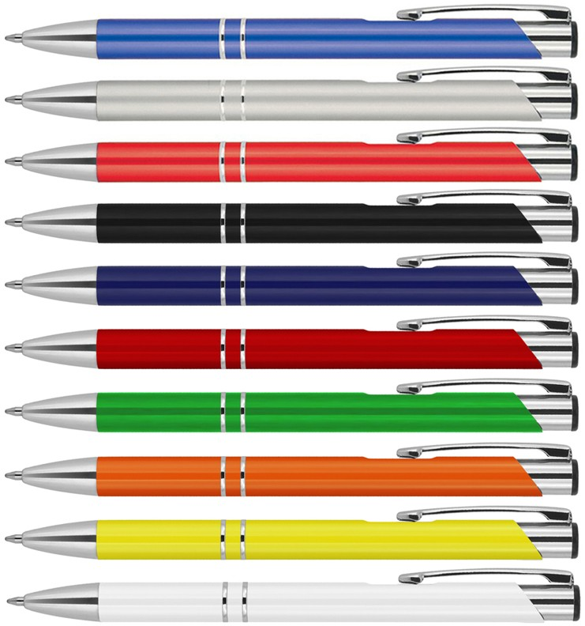
Z550 Metal Pen Ballpoint Executive Julia
The Julia Metallic colour and Solid colour Ballpoint Pens present a sharp, corporate style with smooth, straight lines.
A click action, retractable ballpoint delivers black ink from a smooth, quality Parker type refill - German ink - 4,000m.
This metal promotional pen can be printed with your client's logo or brand to create a fine gift or, alternatively, laser engraved with a white finish for an even classier result. See Z551 for matching mechanical pencil and Z251 for matching plastic pen.
18g metal barrel.
Click action
Retractable ballpoint
Black ink
click
Parker
action
type refill
4,000m
Packaging info
Shipping Carton Qty: 500 Shipping Carton Size:
33.5 x 17.5 x 33.5cm (LxWxH) Carton Weight (kg): 18.7
Colours
J Metallic Blue CT
X Metallic Silver CT
K Metallic Red CT
Print Area
Pad Print (barrel): 50 x 7mm
SA Solid Black CT
SB Solid Blue CT
SC Solid Red CT
Engrave Area
Engrave (barrel): 50 x 7mm Engrave Color: White
SD Solid Green CT
print
SF Solid Orange CT
or
SG Solid Yellow CT
engrave
SW Solid White CT

