Slide 1
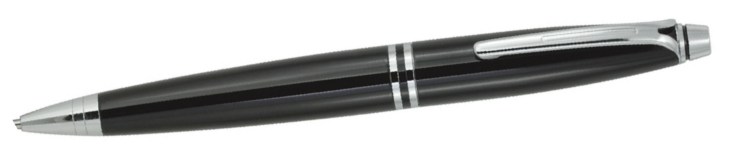
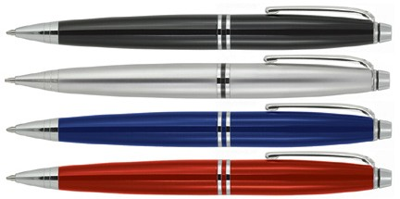
Z529 Metal Pen Ballpoint Prestige Richman
Make your client's corporate gift elegant and refined with the Richman Metal Ballpoint Pen in black with chrome trim.
The substantial, metal barrel exudes quality; with a twist action, retractable ballpoint delivering smooth, black ink from a Parker type refill, this one is sure to satisfy.
Can either be printed or engraved (mirror chrome finish) for an elegant finish with your client's logo on the cap for an ideal professional promotion.
Twist action
Retractable ballpoint
Black ink
twist
cross
action
type
refill
Packaging info
Shipping Carton Qty: 500 Shipping Carton Size:
33.5 x 17.5 x 33.5cm (LxWxH) Carton Weight (kg): 18.7
Colours
A Black CT
B Silver CT
C Blue CT
Print Area
Pad Print (cap): 35 x 7mm
D Red CT
Engrave Area
Engrave (cap): 35 x 7mm Engrave Color: Mirror finish

