Slide 1
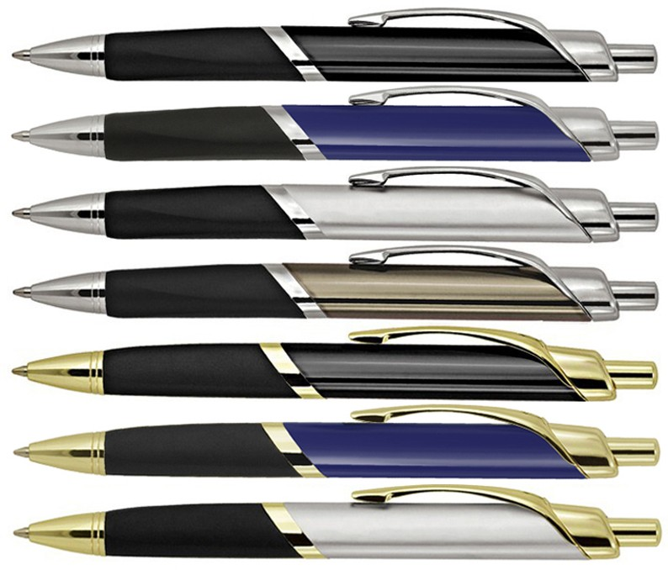
Z520 Metal Pen Ballpoint Prestige Marc
Marc Metal Ballpoint Pen comes styled with contrasting colours, a distinctive round-cornered triangular barrel, and angled features to produce an elegant alternative.
Printed with a logo for your client's promotion, which can be done via pad print to the barrel, this pen will be sure to create a good impression.
The smooth, black ink is from a Parker type refill - German ink - 4,000m and click action, retractable ballpoint.
Click action
Retractable ballpoint
Black ink
click
Parker
action
type
refill
Packaging info
Shipping Carton Qty: 500 Shipping Carton Size:
32 x 27 x 22cm (LxWxH) Carton Weight (kg): 11
Colours
A Black CT
B Blue CT
C Silver CT
Print Area
Pad Print (barrel): 42 x 7mm
D Gunmetal CT
H Black GT
Engrave Area
Engrave (barrel): 42 x 7mm
Engrave Color: GT = Gold, CT = White
I Blue GT
J Silver GT

