Slide 1
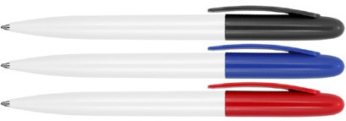
Z432 Plastic Pen Ballpoint Gloss White Sierra
Ergonomic and aerodynamic-style design meets a lightweight construction in the Sierra White Gloss Ballpoint Pen.
Available in bifurcated, classic colorways.
Suitable for pad print, full colour digital print, and rotary screen print.
Twist action
Retractable ballpoint
Black ink
pad
twist
slim
print
action
type refill
1,000m
Packaging info
Shipping Carton Qty: 1,000 Shipping Carton Size:
45 x 31 x 19cm (LxWxH) Carton Weight (kg): 9.7
Colours
A White/Black
B White/Blue
Print Area
Pad Print (lower barrel): 50 x 7mm Pad Print (upper barrel): 35 x 7mm Pad Print (clip): 35 x 6mm
Wrap Print: 45 x 20mm
C White/Red

