Slide 1
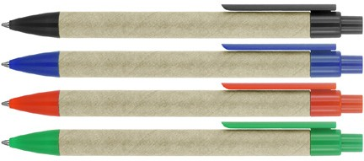
Z427 Eco Pen Ballpoint Recycled Paper Sage
Synonymise your client’s brand with eco-awareness using the Sage Paper Ballpoint Pen. Clip and tip available in a range of colorways.
Suitable for pad print, full colour digital print, and rotary screen print.
Click action
Retractable ballpoint
Black ink
pad &
click
slim
screen
action
type refill
print
1,000m
Packaging info
Shipping Carton Qty: 1,000 Shipping Carton Size:
45 x 31.5 x 17cm (LxWxH) Carton Weight (kg): 9
Colours
A Black
B Blue
C Red
D Green
Print Area
Pad Print: 50 x 7mm Wrap Print: 45 x 20mm

