Slide 1
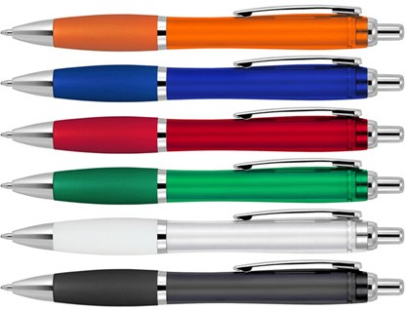
Z422 Plastic Pen Ballpoint Silicone Grip Transparent Cara
With push button, retractable ballpoint, the Cara Silicone Transparent Ballpoint Pen is a classic and stylish quality option for your client’s next promotion.
The plastic barrel can be pad printed with logo branding to create a classy corporate gift.
Plastic Parker type refill - German ink - 4,000m
Push button
Retractable ballpoint
With ergonomic silicone grip
Black ink
Parker
push
type refill
button
Packaging info
Shipping Carton Qty: 1,000 Shipping Carton Size:
50 x 31 x 20cm (LxWxH) Carton Weight (kg): 13
Colours
A Orange
B Blue
C Red
Print Area
Pad Print (barrel): 50 x 7mm
D Green
E White
G Black

