Slide 1
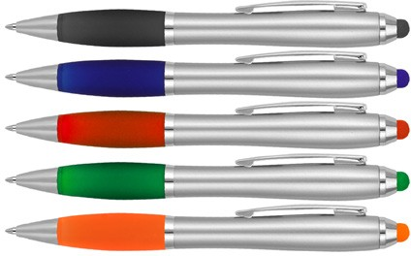
Z418 Plastic Pen Ballpoint Stylus Silver Cara
Ensure your design receives the attention it deserves with our eye-catching Cara Stylus Silver Ballpoint Pen; available in a wide range of colours for the grip and housing a parker type refill, with German ink, rated to 3000m.
Suitable for pad and digital printing.
Twist action
Retractable ballpoint
Black ink
stylus
twist
action
Packaging info
Shipping Carton Qty: 1,000 Shipping Carton Size:
50 x 31 x 20cm (LxWxH) Carton Weight (kg): 13
Colours
A Silver / Black
B Silver / Navy
Print Area
Pad Print (barrel): 50 x 7mm
C Silver / Red
D Silver / Green
F Silver / Orange

