Slide 1
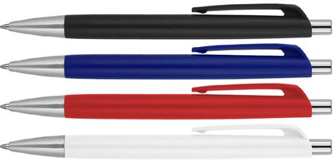
Z416 Plastic Pen Ballpoint Matte Peter
Don't compromise style for simplicity. Have your cake and eat it too with our Peter Matte Ballpoint Pen.
Fitted with a Parker type refill, with German ink rated to 4,000mm, and available in a range of colours.
Suitable for pad, digital, and screen printing.
Click action
Retractable ballpoint
Black ink
Parker
click
type refill
action
Packaging info
Shipping Carton Qty: 1,000 Shipping Carton Size:
48 x 31 x 20cm (LxWxH) Carton Weight (kg): 9
Colours
A Black
B Navy
C Red
Print Area
55 x 7mm
W White

