Slide 1
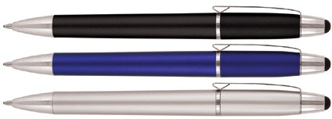
Z410 Plastic Pen Ballpoint Stylus Blaze
The Blaze Matte Stylus Ballpoint Pen is a statement of style and sophistication beyond expectation.
This promotional pen can be pad printed in two positions on the barrel giving your client plenty of options for logos and branding.
With a twist action, retractable ballpoint, the black ink is delivered via a Parker type refill - German ink - 4,000m.
Stylus for smartphones and tablets makes this an ideal choice for the tech savvy and for corporate promotions.
Push button
Retractable ballpoint
Black ink
Packaging info
Shipping Carton Qty: 1,000 Shipping Carton Size:
53 x 31 x 22cm (LxWxH) Carton Weight (kg): 15
Colours
A Black
B Blue
C Silver
Print Area
Pad Print (barrel): 40 x 7mm
Pad Print (upper barrel): 30 x 7mm
stylus
Parker
twist
type refill
action

