Slide 1
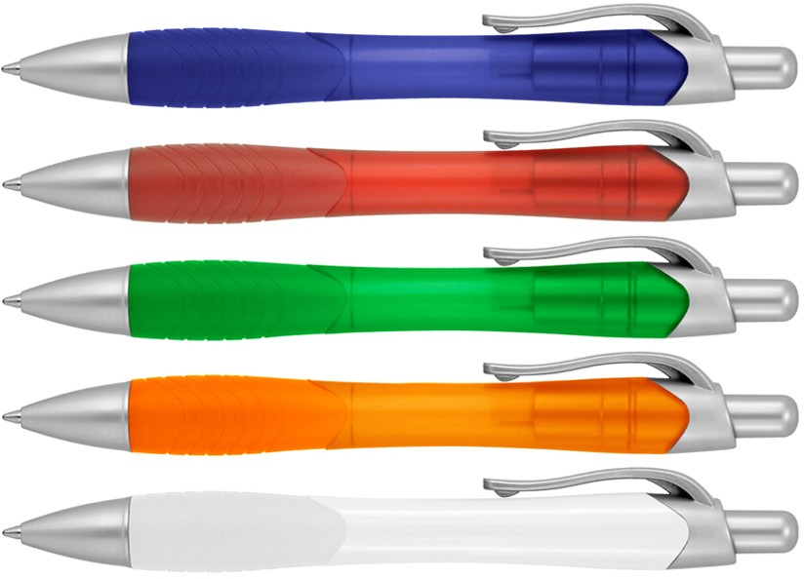
Z408 Plastic Pen Ballpoint Frost Ruby
Equipped with ergonomic rubber grip and quality Parker type refill - German ink - 4,000m, the Ruby Frost Ballpoint Pen will bring contemporary style to your client's next promotion.
Professionally printed with your client's logo, this gift pen features a click action, retractable ballpoint, delivering black ink.
Click action
With ergonomic rubber grip
Retractable ballpoint
Black ink
Parker
click
type refill
action
Packaging info
Shipping Carton Qty: 1,000 Shipping Carton Size:
53 x 31 x 22cm (LxWxH) Carton Weight (kg): 15
Colours
A Blue
B Red
Print Area
Pad Print (barrel): 40 x 7mm
C Green
D Orange
F White

