Slide 1
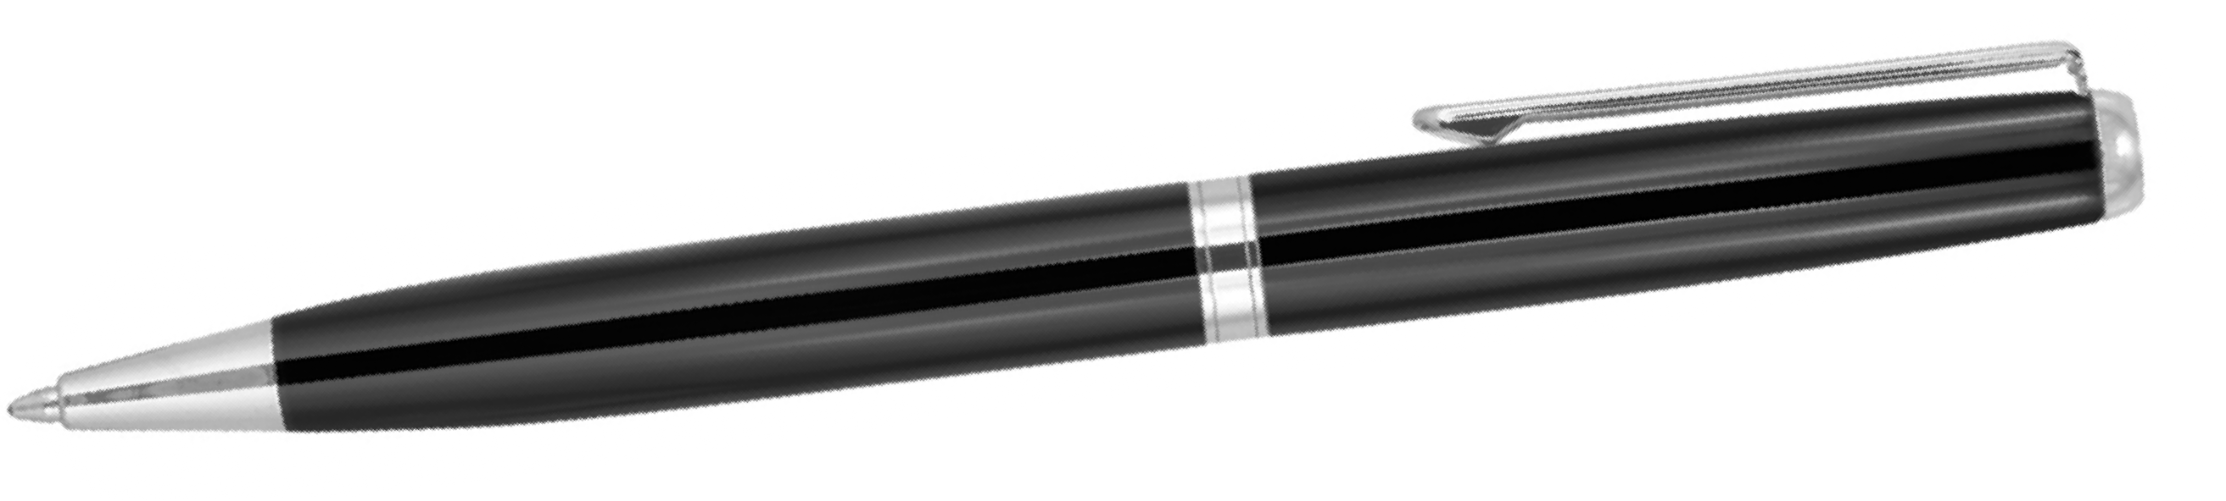
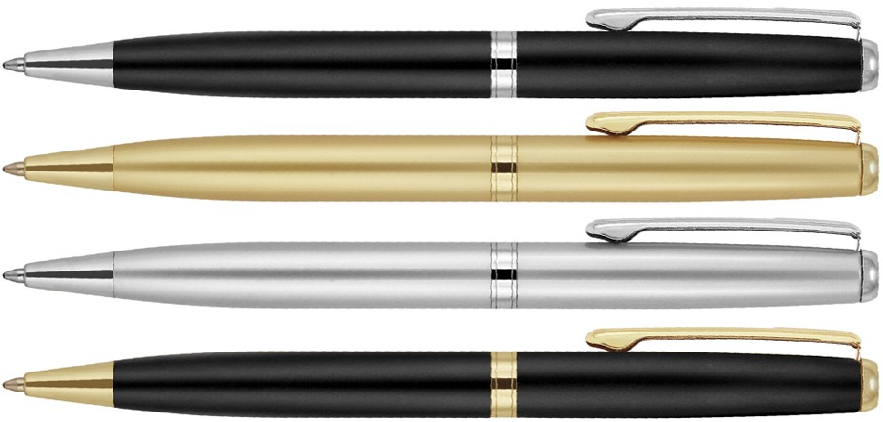
Z281
Metal Pen Ballpoint Prestige Katherine
Exuding pure class, the Katherine Metal Ballpoint Pen is a quality option for your client's pen gift promotion.
A Parker type refill - German ink - 4,000m dispenses black ink and the pen can be professionally printed or laser engraved with a logo or brand for that corporate finish.
Quality metal barrel and twist action, retractable ballpoint.
Twist Action
Retractable ballpoint
Black ink
print
twist
Parker
or
action
type refill
engrave
Packaging info
Shipping Carton Qty: 500 Shipping Carton Size:
33.5 x 17.5 x 33.5cm (LxWxH) Carton Weight (kg): 18.7
Colours
Black CT
Satin Gold GT
Print Area
Pad Print (barrel): 40 x 7mm Pad Print (cap): 48 x 7mm
Satin Silver CT
Black CT
Engrave Area
Engrave (cap): 48 x 7mm Engrave Color:
A, B, and C = Mirror Chrome Finish D = Mirror Gold Finish

