Slide 1
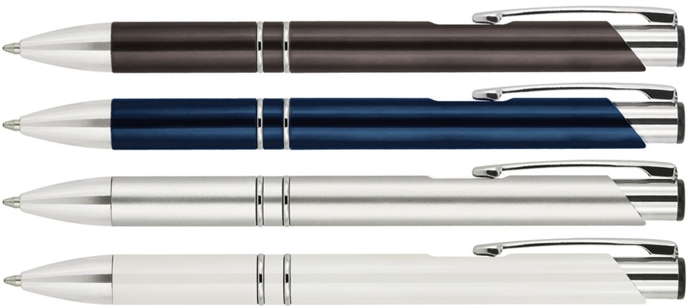
Z251 Plastic Pen Ballpoint Julia
The Julia Plastic Ballpoint Pen presents a sharp corporate style with smooth straight lines.
A click action, retractable ballpoint delivers black ink from a smooth quality Parker type refill - German ink - 4,000m.
This promotional pen can be printed with your client's logo or brand to create a fine gift. See Z551 for matching mechanical pencil and Z550 for matching metal pen.
Click action
Retractable ballpoint
Black ink
Parker
click
type refill
action
Packaging info
Shipping Carton Qty: 1,000 Shipping Carton Size:
53 x 31 x 22cm (LxWxH) Carton Weight (kg): 15
Colours
A Black
B Blue
C Silver
Print Area
Pad Print (barrel): 50 x 7mm
W White

