Slide 1
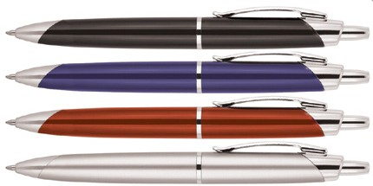
Z246 Plastic Pen Ballpoint Leonardo
You may find it hard to imagine a plastic pen with quality, class, and style but the Leonardo Ballpoint Pen come up trumps in all departments.
Printed with your client's promotional logo to upper and/or lower barrel, this elegant pen will make a great executive gift at a fraction of the cost.
Equipped with click action, retractable ballpoint, the black ink is delivered via a quality Parker type refill - German ink - 4,000m.
Click action
Retractable ballpoint
Black ink
Parker
click
type refill
action
Packaging info
Shipping Carton Qty: 1,000 Shipping Carton Size:
53 x 31 x 22cm (LxWxH) Carton Weight (kg): 15
Colours
A Black
B Blue
C Red
Print Area
Pad Print (lower barrel): 40 x 8mm Pad Print (upper barrel): 35 x 8mm
D Silver

