Slide 1
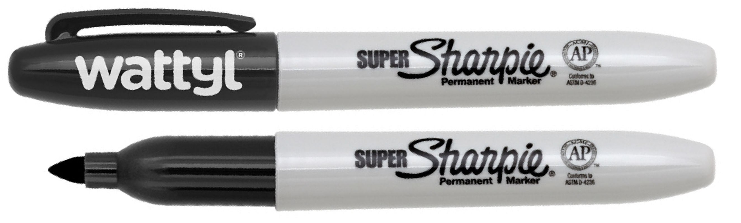
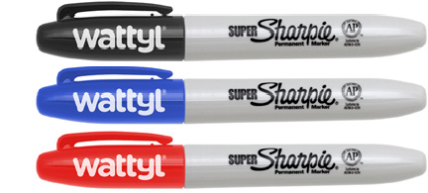
SH300 Marker Permanent Sharpie Super
Your customers can now make their mark permanently with this co-branding opportunity on the world’s #1-selling marker - the Sharpie Super Permanent Marker.
The fine point has permanent, fast-drying, ac- id-free, non-toxic ink that is ACMI certified; and with a super-large ink supply, you can express yourself to your heart’s content. Instantly rec- ognisable, these iconic markers are well loved around the world and always praised for their quality.
The perfect co-branding opportunity - collabo- rate and elevate!
Permanent on most hard-to-mark surfaces
Quick-drying, AP Certified, non-toxic ink formula
Line width - 1.5mm
made
cap
colour
in USA
is ink
colour
Packaging info
Shipping Carton Qty: 144 Shipping Carton Size:
30.48 x 18.72 x 9.98cm (LxWxH) Carton Weight (kg): 1.74
Colours
A Black
B Blue
Print Area
Pad Print (cap): 35 x 7mm
C Red

