Slide 1
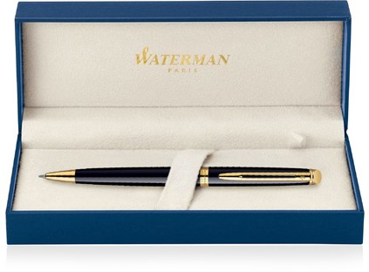
Hemisphere Metal Pen Ballpoint Waterman Hemisphere - Lacquer Black GT MADE IN FRANCE S20102009 |  |  | Cap Decal Brass Gold Finish Barrel band: 23K Gold Finish Stainless Steel with Gold Finish | Cap Tassie Brass Gold Finish Clip Trim: 23K Gold Finish Barrel: Black Lacquer
Packaging info | Print Area
Shipping Carton Qty: 100 Shipping Carton Size: 41 x 38 x 38cm (LxWxH) Carton Weight (kg): 18.5 | Pad Print: 40 x 7mm Engrave Area Engrave: 40 x 7mm Engrave Color: Gold

