Slide 1

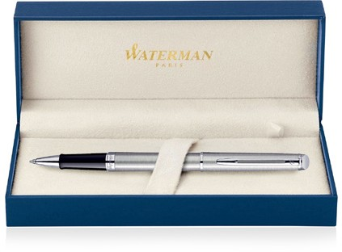
 |  | Cap Decal Palladium Finish |  |  | Cap Tassie Palladium Finish
Hemisphere Metal Pen Rollerball Waterman Hemisphere Brushed Stainless CT MADE IN FRANCE S20102006 |  | Barrel band: Palladium Finish |  |  | Clip Trim: Palladium Finish
 |  |  |  |  | Barrel: Brushed Stainless Steel
 |  |  |  |  | Shell Material: Molded Plastic
 |  | Stainless Steel Finish
Packaging info | Print Area
Shipping Carton Qty: 100 Shipping Carton Size: 41 x 38 x 38cm (LxWxH) Carton Weight (kg): 18.5 | Pad Print: 40 x 7mm Engrave Area Engrave: 40 x 7mm Engrave Color: Silver

