Slide 1
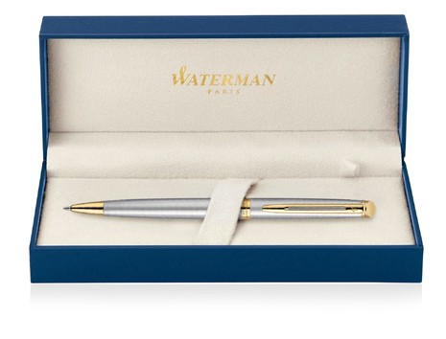
Hemisphere Metal Pen Ballpoint Waterman Hemisphere - Brushed Stainless GT MADE IN FRANCE S20102003 |  |  | Cap Decal Brass Gold Finish Barrel band: Brass Gold Finish Stainless Steel with Gold Finish | Cap Tassie Brass Gold Finish Clip Trim: Brass Gold Finish Barrel: Brushed Stainless Steel
Packaging info | Print Area
Shipping Carton Qty: 100 Shipping Carton Size: 41 x 38 x 38cm (LxWxH) Carton Weight (kg): 18.5 | Pad Print: 40 x 7mm Engrave Area Engrave: 40 x 7mm Engrave Color: Silver

