Slide 1

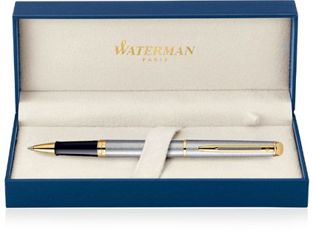
 |  |  | Cap Decal Brass Gold Finish |  | Cap Tassie Brass Gold Finish
Hemisphere Metal Pen Rollerball Waterman Hemisphere - Brushed Stainless GT MADE IN FRANCE S20102002 |  |  | Barrel band: Brass Gold Finish |  | Clip Trim: Brass Gold Finish
 |  |  |  |  | Barrel & Cap: Brushed Stainless Steel
 |  |  |  |  | Shell Material: Molded Plastic
 |  |  | Stainless Steel with Gold Finish
Packaging info | Print Area
Shipping Carton Qty: 100 Shipping Carton Size: 41 x 38 x 38cm (LxWxH) Carton Weight (kg): 18.5 | Pad Print: 40 x 7mm Engrave Area Engrave: 40 x 7mm Engrave Color: Silver

