Slide 1
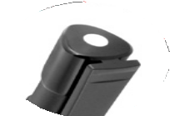
P923 Plastic Pen Ballpoint High Gloss Fantastico
Emanating an image of resilience,
the Fantastico High Gloss Ballpoint Pen evokes notions of quiet confidence; with an accented tip that also blends sophistication.
Available in black and white and suitable for pad print, full colour digital print, and rotary screen print.
Click action
Retractable ballpoint
Black ink
pad
click
slim
print
action
type refill
1,000m
Packaging info
Shipping Carton Qty: 1,000 Shipping Carton Size:
43 x 32 x 20cm (LxWxH) Carton Weight (kg): 8
Colours
A Black
W White
Print Area
Pad Print: 55 x 7mm Wrap Print: 50 x 20mm

