Slide 1
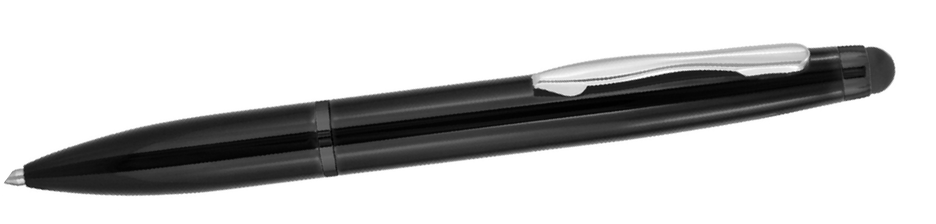
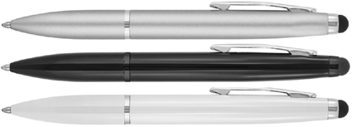
P321 Metal Pen Ballpoint Prestige Stylus 2 in 1
A classy and elegant gift option for those with smartphone or tablet, the 2 in 1 Metal Stylus Ballpoint Pen features twist action, retractable ballpoint as well as a stylus for screen use.
Black ink is delivered with reliability, smoothness, and style by a Parker type refill - German ink - 4,000m.
Laser engrave in chrome (black pen only) finish, or choose to pad print your client's logo to the metal barrel for an unrivaled promotion or personalised gift for the tech savvy.
Twist Action
Retractable ballpoint
Black ink
twist
Parker
action
type refill
Packaging info
Shipping Carton Qty: 500 Shipping Carton Size:
33.5 x 17.5 x 33.5cm (LxWxH) Carton Weight (kg): 18.7
Colours
A Silver
B Black
C White
Print Area
Pad Print (barrel): 50 x 6mm
Engrave Area
Engrave (barrel): 50 x 6mm
Engrave Color: B engraves Chrome; no engrave for A or C
print
or
stylus
engrave

