Slide 1
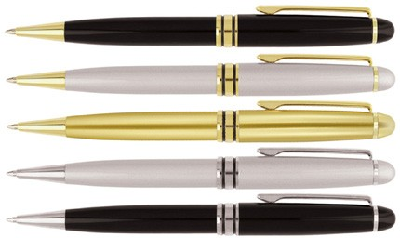
P15 Metal Pen Ballpoint Prestige Classical
You'll be sure to impress with our Classical Metal Ballpoint Pen.
The classy metal barrel is reassuringly weighty in the hand and can be printed or stylishly laser engraved in gold with your client's promotional logo to either cap or barrel.
With a twist action, retractable ballpoint delivering black ink from a Parker type refill - German ink - 4,000m, this is a promotional pen that brings classical style.
Twist Action
Retractable ballpoint
Black ink
print
twist
Parker
or
action
type refill
engrave
Packaging info
Shipping Carton Qty: 500
Shipping Carton Size: 35.1 x 17 x 27.3cm (LxWxH)
Carton Weight (kg): 15
Colours
A Black GT
F Silver GT
N Gold GT
Print Area
Pad Print (cap): 35 x 7mm Screen Print (barrel): 30 x 25mm
G Silver CT
H Black CT
Engrave Area
Engrave (cap): 35 x 7mm
Engrave Color: GT engraves Gold;
CT engraves Chrome

