Slide 1
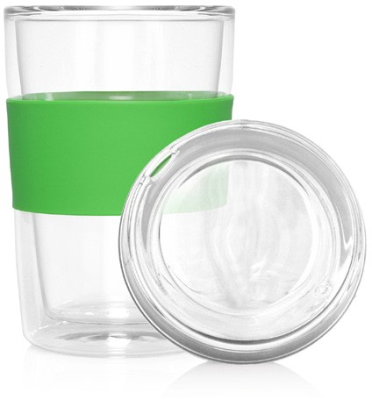
M309
Eco Coffee Cup Glass Lid Double Wall Cup2Go 300ml
The 300ml, double-walled, glass Cup 2 Go provides an excellent return on investment. An everyday item that has the potential to be used ALL day; in the home or office without the glass lid or in the car with the glass lid installed. And, of course, the more it is used the more visible the logo and the more effective the promotion.
Glass is becoming an increasingly popular choice because, in addition to being environmentally responsible, it also provides a clean taste and is an exceptionally hygienic material.
Logos can be printed on the silicone band.
Sold in a retail quality gift box.
Print Area
Band: 65 x 25mm
Packaging info
Product Dimension: Ø80 x 163mm (incl. lid) Shipping Carton Qty: 12
Shipping Carton Size: 38 x 29 x 21cm (LxWxH) Shipping Carton Weight (kg): 4.7
Double walled design keeps hot drinks hot without burning your fingers
Glass lid and colourful sleeve
Food grade glass
Colours
A
C
D
F
G
I
M

