Slide 1
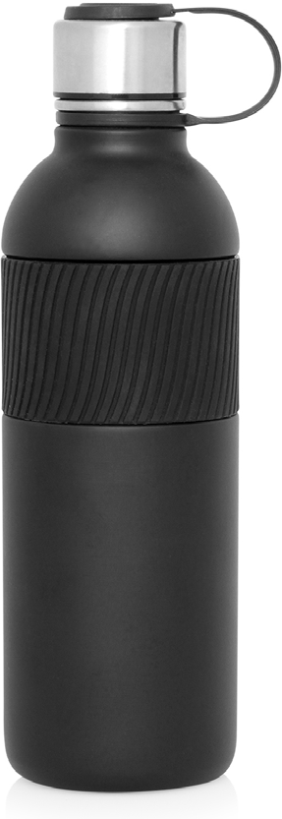
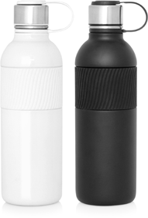
M294 Bottle Stainless Double Wall 600ml
Stay hydrated with these stylish and practical stainless steel sports bottles. They laser engrave beautifully and looking fantastic with a full colour digital print.
The bottle’s usability and high visibility make it a brilliant printed promotional product. Students and fitness/outdoor enthusiasts will love them but, then again, so will anyone who likes to carry a little hydration with them... which as we ALL know these days is an important key to good health.
Not microwave or dishwasher safe.
Food grade #304 stainless
Print Area
TBC
Engrave Area
TBC
Packaging info
Product Dimension: ø75 x 250mm
Shipping Carton Qty: 36 Shipping Carton Size:
55 x 55 x 28cm (LxWxH) Shipping Carton Weight (kg): 12
Colours
White
Black
double
walled
stainless
steel
bottles

