Slide 1
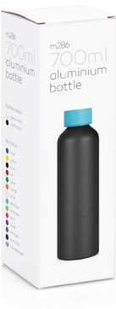
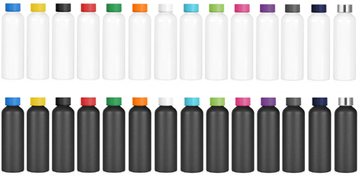
M286 Bottle Aluminium 700ml
Enjoy your favourite drinks on the sports
field with these promo sports bottles.
Featuring a light-weight and durable aluminium construction, including a BPA free liner with colourful lid, they are an excellent place to sport your client’s logo.
Lightweight and durable
Food grade aluminium construction
Colourful stainless lid
Packaging info
Product Dimension: Ø66 x 217mm Shipping Carton Qty: 36
Shipping Carton Size:
41 x 41 x 24cm (LxWxH)
Shipping Carton Weight (kg): 4.7
Print Area
Pad: 70 x 35mm Digital: 150 x 25mm
Colours
A LA White / Blue
A LB White / Yellow A LC White / Black A LD White / Red
A LE White / Green A LF White / Orange A LG White / White
A LH White / Light Blue A LI White / Line Green A LJ White / Pink
A LK White / Purple A LL White / Grey
A LM White / Navy Blue
A LX White / Stainless Steel
C LA Black / Blue
C LB Black / Yellow C LC Black / Black C LD Black / Red
C LE Black / Green C LF Black / Orange C LG Black / White
C LH Black / Light Blue C LI Black / Line Green C LJ Black / Pink
C LK Black / Purple C LL Black / Grey
C LM Black / Navy Blue
C LX Black / Stainless Steel
Engrave Area
Ø35mm (lid)
Engrave Colour: Silver
aluminium
bottle

