Slide 1
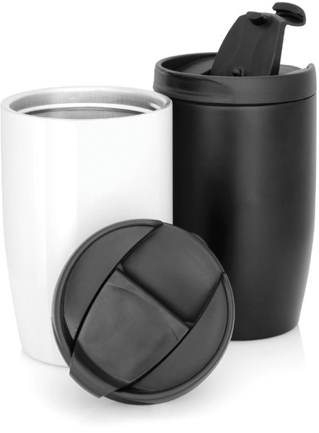
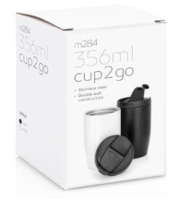
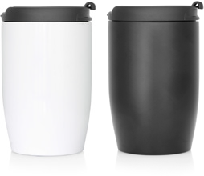
M284
Eco Coffee Cup Stainless Double Wall Cup2Go 356ml
With the disposal of environmentally harmful plastic cups in today's society, nothing reflects awareness and sustainability in a business more than promotional stainless steel coffee cups.
Presenting, our new double walled, stainless steel Cup 2 Go which sports a stylish design with screw-top lid (with flip- top to prevent annoying splashes).
This promotional stainless coffee cup is the perfect gift for the ecologically aware and practical minded customer.
Sold in a retail quality gift box.
Capacity: 356ml/12oz
Screw-on hard plastic lid with lip-top
Material: Food grade #304 stainless
steel inner, #201 outer
Not dishwasher safe
Not microwave safe
Sold in a retail quality gift box
Print Area
Cup (pad): 40 x 40mm Cup (screen):
240 x 50mm (1 col wrap only)
Packaging info
Product Dimension: Ø80 x 135mm
Shipping Carton Qty: 50 Shipping Carton Size:
46 x 46 x 30cm (LxWxH)
Shipping Carton Weight (kg): 13.5
Colours
A White
C Black

