Slide 1
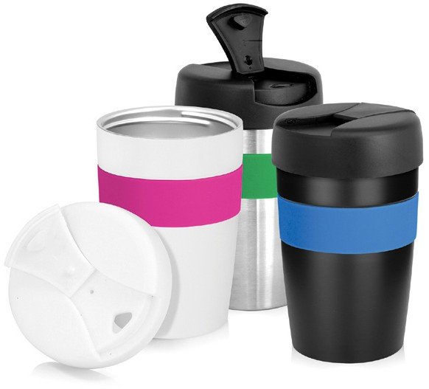
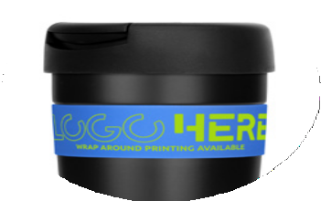
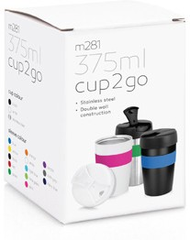



M281
Eco Coffee Cup Stainless Double Wall Cup2Go 375ml
Mix 'n' match cups and band colours
Screw-on hard plastic lid with flip-top
Silicone band
Food grade Stainless Steel
Double wall construction
Lid Material: PP - BPA free
Not dishwasher or microwave safe
Sold in a retail quality gift box
Print Area
Cup (pad): 25 x 30mm Band (screen): 200 x 18mm
(1 col wrap only)
Engrave Area
Cup: 25 x 30mm
Packaging info
Product Dimension: Ø88 x 138mm Shipping Carton Qty: 30
Shipping Carton Size:
60.5 x 51 x 16.5cm (LxWxH) Shipping Carton Weight (kg): 8.54
Colours
wrap
around
printing
available
Cup Colour
CA
CB
CC
Band Colours
SA
SB
SC
SD
SE
SF
SG
SH
SI
SJ
SK
SL
SM

