Slide 1
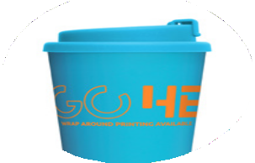
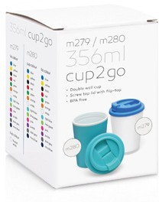
M280
Eco Coffee Cup
Plastic Double Wall Cup2Go 356ml
wrap
around
printing
available
Print Area
Screenprint: 200 x 80mm Digital print: 26 x 80mm
mix ‘n’
Many cup colours with many lid colours to choose from
356ml/12oz capacity
Screw-on threaded lid
Material: Food grade PP - BPA free
match
your business
colours
Packaging info
Product Dimension: Ø90 x 135mm Shipping Carton Qty: 70
Shipping Carton Size:
59 x 42 x 32cm (LxWxH) Shipping Carton Weight (kg): 6
Prices include up to 5 mix 'n' match colour combinations per order. For orders with more than 5 colour combinations please contact sales staff for details.
Optional gift box available for an additional charge
Colours
Cup Colour
CA
CB
CC
CD
CE
CF
CG
CH
CI
CJ
CK
CL
CM
Lid Colours
LA
LB
LC
LD
LE
LF
LG
LH
LI
LJ
LK
LL
LM

