Slide 1
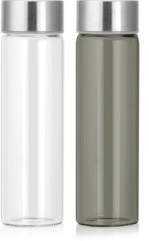
M277 Bottle Tritan 500ml
Modern design meets practical application in this Tritan water bottle.
Made of food-grade, BPA free Tritan plastic, this bottle features a very large print area, decorated by pad print.
Food grade BPA
free tritan plastic
Huge print area
BPA FREE
tritan
bottles
Print Area
35 x 75mm
Packaging info
Product Dimension: ø64 x 215mm Shipping Carton Qty: 36
Shipping Carton Size:
44 x 44 x 23cm (LxWxH)
Shipping Carton Weight (kg): 4.5
Colours
Clear
Grey

