Slide 1
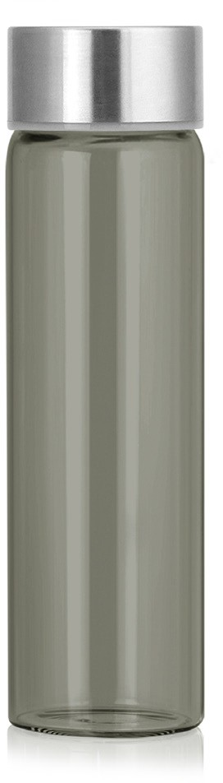
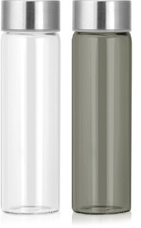
M276 Bottle Tritan 800ml
Modern design meets practical application in this Tritan water bottle.
Made of food-grade, BPA free Tritan plastic, this bottle features a very large print area, decorated by pad print.
Food grade BPA free tritan plastic
Huge print area
Print Area
35 x 75mm
Packaging info
Product Dimension: ø69 x 249mm Shipping Carton Qty: 36
Shipping Carton Size:
44 x 44 x 26cm (LxWxH) Shipping Carton Weight (kg): 6
Colours
Clear
Grey
BPA FREE
tritan
bottles

