Slide 1
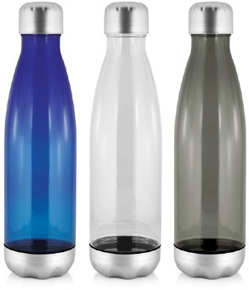
M273 Bottle Tritan 700ml
Enjoy a pleasing, efficient design in this Tritan water bottle.
Made of food-grade, BPA free Tritan plastic, this bottle is as lightweight as it is durable.
Featuring a very large print area, this bottle can be decorated by pad print.
Food grade BPA free tritan plastic
Light-weight and durable
Great print area
Print Area
Pad: 75 x 35mm
Digital: 100 x 25mm
Packaging info
Product Dimension: ø70 x 257mm Shipping Carton Qty: 36
Shipping Carton Size:
44 x 44 x 27cm (LxWxH) Shipping Carton Weight (kg): 4
Colours
Blue
Clear
B Grey
BPA FREE
tritan
bottles

