Slide 1
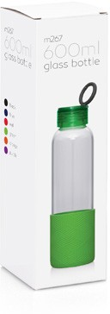
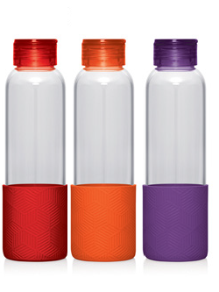
M267 Bottle Glass 600ml
Bright coloured silcone and glass, glass, glass… We love glass because it's hygienic, looks great, is
environmentally friendly, and provides for clean tasting drinking water. Available in an awesome range of colours. Did we mention that it also had a neat little integrated carry loop in the lid? Because it does...
Not suitable for hot liquids.
Food grade glass bottle with colourful silicone sleeve
600ml capacity
Print Area
60 x 35mm
Packaging info
Product Dimension: Ø67 x 229mm Shipping Carton Qty: 25
Shipping Carton Size:
41 x 41 x 27cm (LxWxH) Shipping Carton Weight (kg): 10
glass
bottles
Colours
C Red
Orange
Purple

