Slide 1
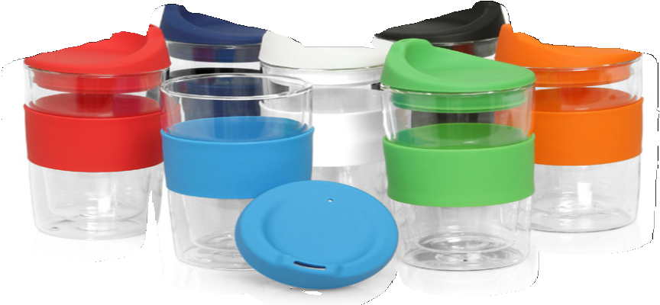
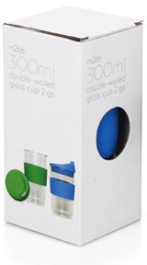
M266 Eco Coffee Cup Glass Double Wall Cup2Go 300ml
The 300ml, double-walled, Glass Cup 2 Go provides an excellent return on investment. An everyday item that has the potential to be used ALL day; in the home or office without the lid or in the car with the lid installed. And, of course, the more it is used the more visible the logo and the more effective the promotion.
Glass is becoming an increasingly popular choice because, in addition to being environmentally responsible, it also provides a clean taste and is an exceptionally hygienic material.
Logos can be printed on the silicone band.
Sold in a retail quality gift box.
Print Area
Band: 65 x 25mm
Double-walled design keeps hot drinks hot without burning your fingers
Colourful lid and sleeve
300ml capacity
Can be used with or without the lid in the car or in the office
Food grade glass
Packaging info
Product Dimension: Ø80 x 163mm (incl. lid) Shipping Carton Qty: 12
Shipping Carton Size: 38 x 28 x 20cm (LxWxH) Shipping Carton Weight (kg): 5
Colours
A
C
D
F
G
I
M

