Slide 1
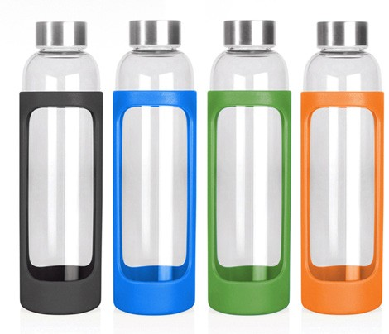
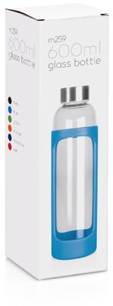
M259 Bottle Glass 600ml
We love this product!
Glass is a natural choice for a clean, pure taste - it's easy to clean and more environmentally sound for our oceans and landfills. This fantastic, lightweight, glass bottle, with a stainless steel threaded lid, is great for the home, office, or recreational purposes. It features a protective silicone sleeved grip that will beautifully frame your client's logo.
Logo is printed on the glass bottle area between the silicone grip. Sold in a retail quality gift box.
Not suitable for hot liquids.
Food grade glass bottle with colourful silicone sleeve
Stainless steel threaded lid
600ml capacity
glass
bottles
Print Area
Pad: 75 x 35mm
Engrave Area
Ø35mm (lid)
Packaging info
Product Dimension: Ø67 x 229mm Shipping Carton Qty: 36
Shipping Carton Size:
42 x 42 x 24.8cm (LxWxH) Shipping Carton Weight (kg): 14.8
Colours
Black
Blue
Green
Orange
Red
Blue
J Navy

