Slide 1
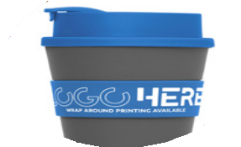
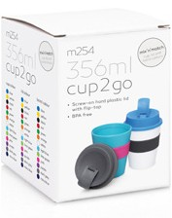
M254 Eco Coffee Cup Plastic Cup2Go 356ml
mix ‘n’
match
your business
colours
Sporting a stylish design with screw-top lid and silicone band, this promotional coffee cup is the perfect gift for the ecologically aware and practical minded customer.
356ml/12oz capacity
“Screw-on” threaded lid
Hard plastic lid, silicone band
Material: Food grade
PP - BPA free
wrap
around
printing
available
Prices include up to 5 mix 'n' match colour combinations per order. For orders with more than 5 colour combinations please contact sales staff for details.
Print Area
Band (pad): 60 x 18mm Band (screen):
200 x 20mm (1 col wrap only) Cup (pad): 25 x 20mm
Cup (digital): 25 x 20mm
Packaging info
Product Dimension: Ø90 x 115mm Shipping Carton Qty: 100 Shipping Carton Size:
60 x 40 x 40cm (LxWxH)
Shipping Carton Weight (kg): 10
Optional gift box available for an additional charge
MCUP Colours
MBAND Colours
A
B
C
D
E
F
G
H
I
J
K
L
M
A
B
C
D
E
F
G
H
I
J
K
L
M
Lid Colours
LA
LB
LC
LD
LE
LF
LG
LH
LI
LJ
LK
LL
LM

