Slide 1
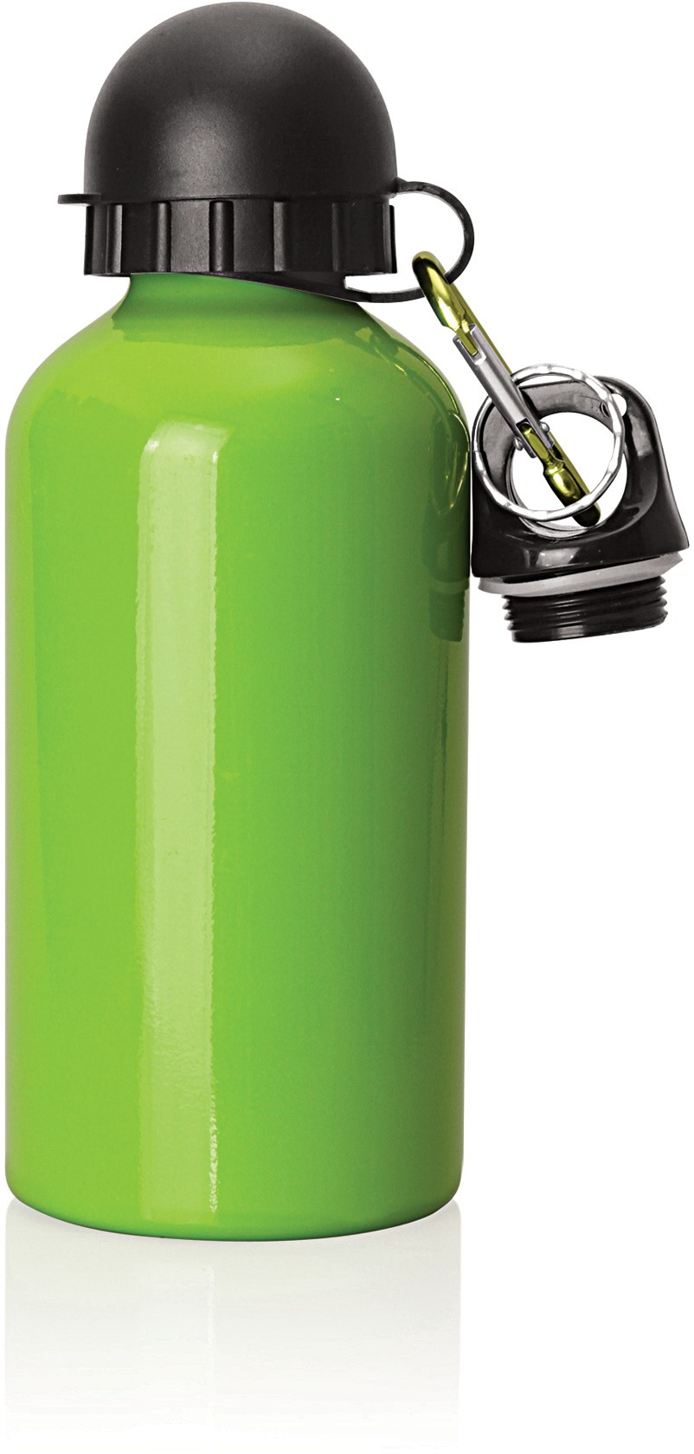
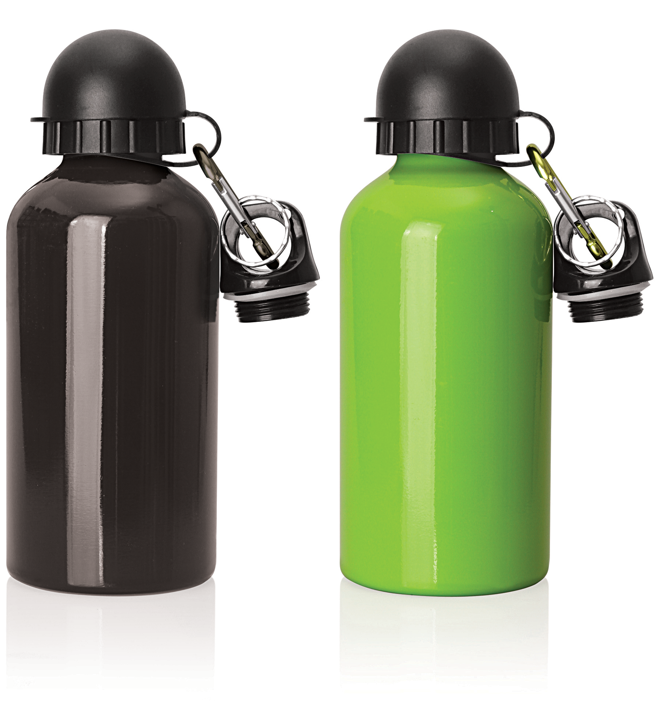
M217 Bottle Aluminium 500ml
Enjoy your favourite drinks on the sports field with these promo sports bottles.
Featuring a lightweight and durable aluminium construction, including a BPA free liner and sports and carabiner lids, they are an excellent place to sport your client's logo.
Lightweight and durable
Food grade aluminium construction with BPA free liner
Sports lid and traditional carabiner lid
aluminium
bottles
Print Area
35 x 40mm
Engrave Area
35 x 100mm
Packaging info
Product Dimension: Ø73 x 185mm Shipping Carton Qty: 50
Shipping Carton Size:
80 x 42 x 22cm (LxWxH) Shipping Carton Weight (kg): 7
Colours
A Black
E Green

