Slide 1
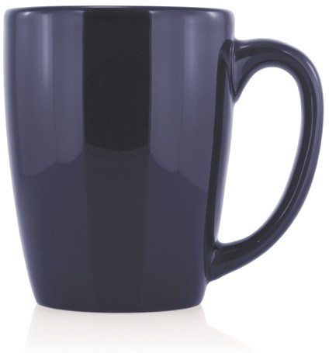
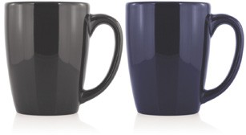
M213 Ceramic Mug Brighton 300ml
A classic ceramic mug to carry your client’s logo - the perfect traditional promotional gift.
300ml capacity
Food grade ceramic
food
grade
ceramic
Packaging info
Product Dimension: Ø84 x 102mm Shipping Carton Qty: 36
Shipping Carton Size:
40 x 27 x 31cm (LxWxH) Shipping Carton Weight (kg): 14
Print Area
40 x 40mm
Colours
A Black
C Blue

