Slide 1
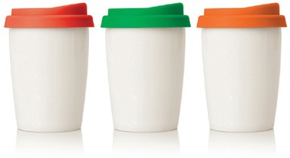
M211 Eco Coffee Travel Mug Ceramic 270ml
double
walled
Become an environmentally friendly world citizen with this ceramic travel mug, saving the waste of all those takeaway cups.
A double walled, dishwasher safe construction with colourful silicone lid make this a stylish and practical promotional product.
300ml food grade ceramic
Double walled
Dishwasher safe
BPA free
with
food
silicone
grade
lid
ceramic
Packaging info
Product Dimension: Ø80 x 110mm Shipping Carton Qty: 20
Shipping Carton Size:
50 x 22 x 27cm (LxWxH)
Shipping Carton Weight (kg): 8.3
Print Area
35 x 30mm
Colours
A White
Red
Green
Orange

