Slide 1
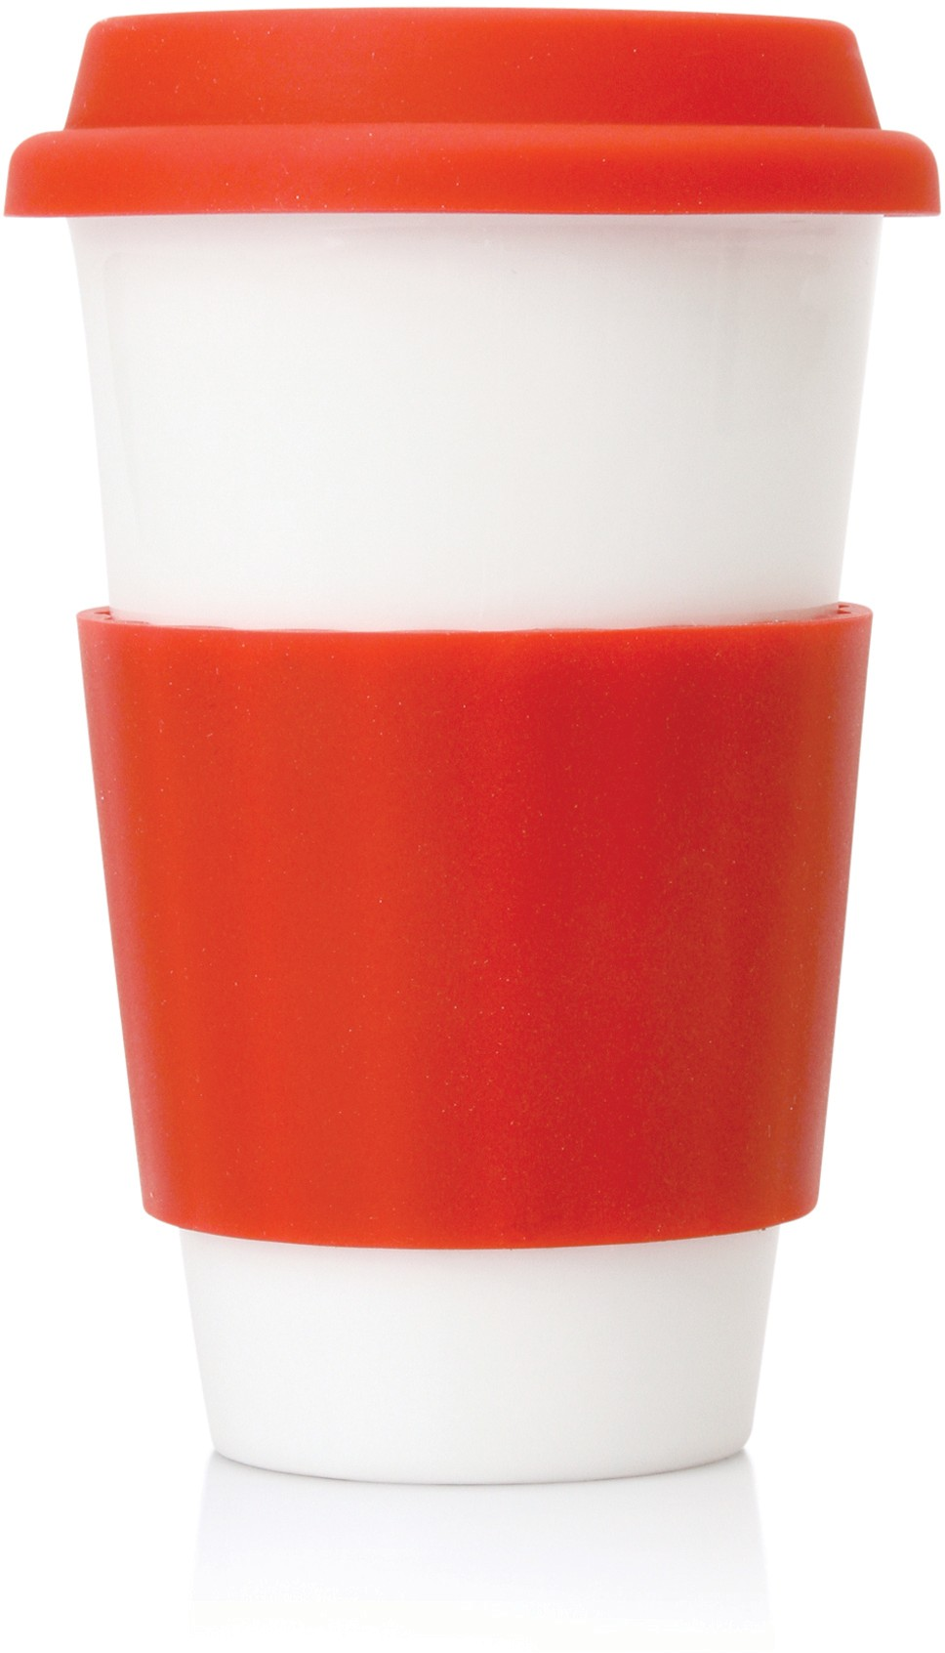
M209 Eco Coffee Travel Mug Ceramic 300ml
food
double
grade
walled
ceramic
Become an environmentally friendly world citizen with this ceramic travel mug, saving the waste of all those takeaway cups.
A double walled, dishwasher safe, construction with colourful silicone lid and sleeve make this a stylish and practical promotional product.
300ml food grade ceramic
Double walled
Dishwasher safe
BPA free
with
silicone
band
& lid
Packaging info
Product Dimension: Ø95 x 175mm
Shipping Carton Qty: 24 Shipping Carton Size:
49 x 33 x 18cm (LxWxH) Shipping Carton Weight (kg): 12
Print Area
35 x 30mm (ceramic) 35 x 35mm (silicone)
Colours
Black
Red

