Slide 1
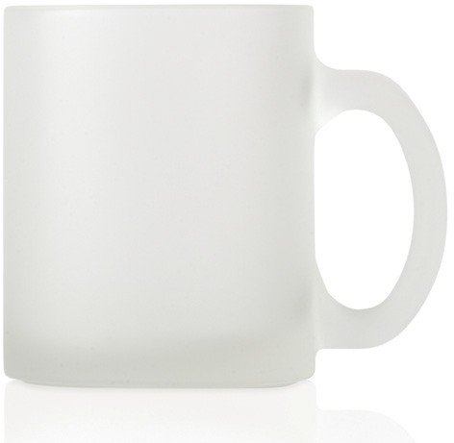
M120 Glass Mug Frosted
food
grade
ceramic
This frosted glass mug has plenty of potential as a promotional gift to carry your client’s logo.
Capacity 325ml
Food grade ceramic
Packaging info
Product Dimension: Ø80 x 95mm Shipping Carton Qty: 36 Shipping Carton Size:
41 x 28 x 34cm (LxWxH) Shipping Carton Weight (kg): 15
Print Area
185 x 70mm
Colours
White

